Slide 1
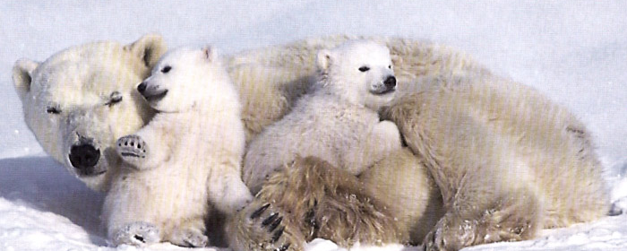
History
Polar bears are an often-used image for the victims of climate change. But they may encourage people who live far from the poles to think that “it won’t affect me”.
How long have we known about the global warming?

Slide 2
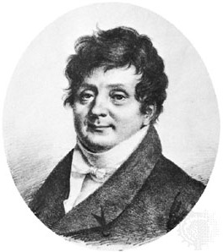
Jean-Baptiste Joseph Fourier
Fourier’s "fish" question: Why should a rock in space be anything but cold and miserable?
https://en.wikipedia.org/wiki/File:Joseph_Fourier_(circa_1820).jpg
57 F is our present day estimate of Earth’s global average temperature.
1820s - Fourier calculated the temperature of a body the size of Earth and our distance away from the sun. But it should be waaaaay colder.
He considered the possibility that there was “something” in our atmosphere that kept some of the Sun’s warmth from leaking out, a sort of insulating blanket. Sort of like a “Greenhouse”.
Present day estimate: with no greenhouse gases in the atmosphere, Earth would be about 0 F. This 57 degree difference is the “natural greenhouse effect”.

Slide 3
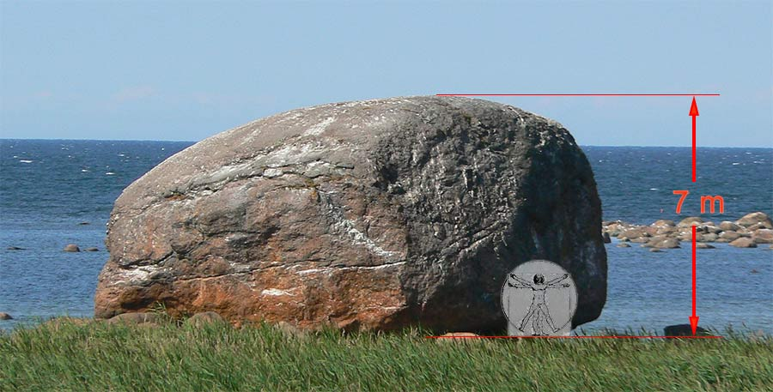
New discoveries about Earth’s past
An “erratic” boulder in Estonia

Slide 4
Erratic boulders
n the mid-1800s scientists became fascinated by "erratic" boulders. These are large rocks of a different type from most other local stone. It's as if they have been "carried" from another place.
One early explanation was that a great flood had carried them from one place to another.
Observant Swiss, among them the engineer Ignaz Venetz, noticed the boulders below glaciers. Had these moving “rivers of ice” carried the boulders along? Venetz proposed (1821) that much of Northern Europe had once been covered by glaciers.
Louis Agassiz, a naturalist and world renowned expert on fossil fish, was convinced by Jean Charpentier and others to visit the Aar Glacier in the Swiss Jura…

Slide 5
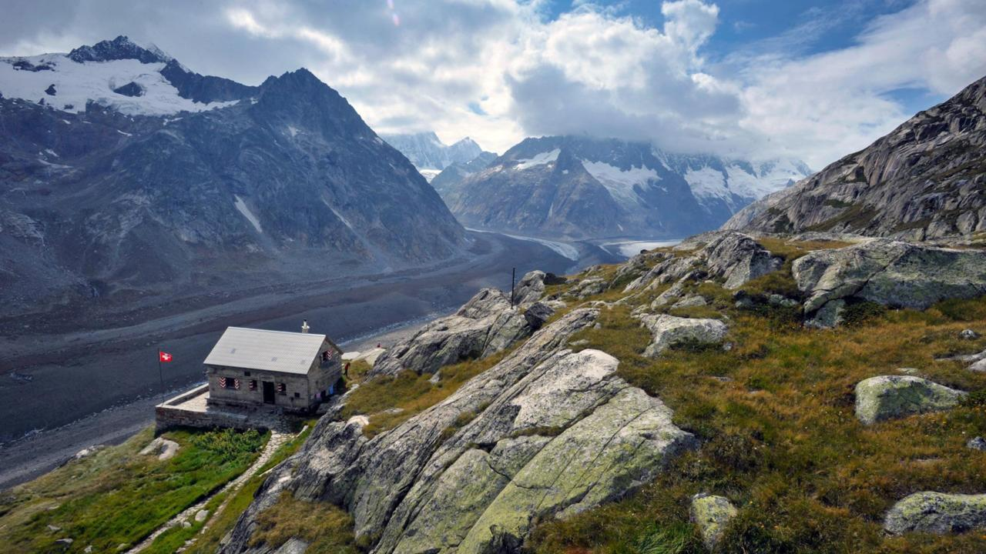
Glacial landscape of Swiss Jura

Slide 6
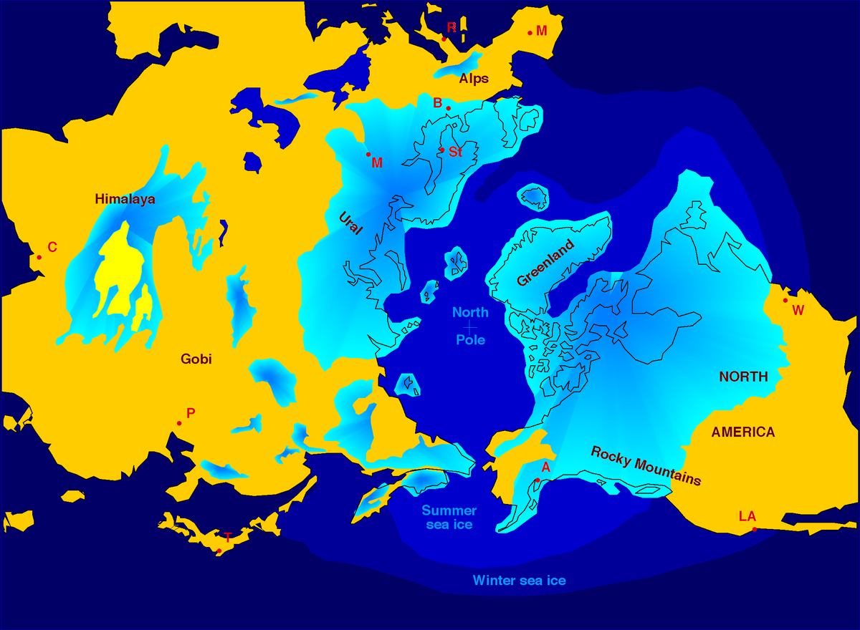
Ice ages
Invited (1837) to talk to Swiss Natural History Society about his specialty, fossil fish, Agassiz instead decided to talk about something completely different: He proposed that Earth's climate goes through drastic changes, and that the whole Northern Hemisphere had once been covered with glaciers.

Slide 7
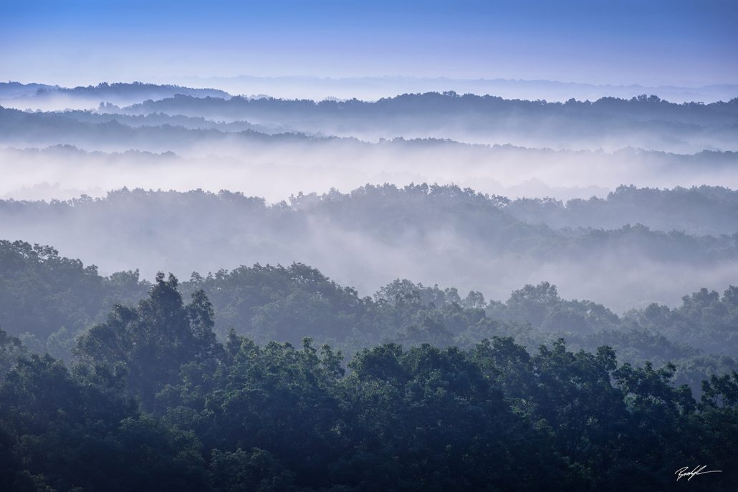
Southern Indiana (Brown County)

Slide 8
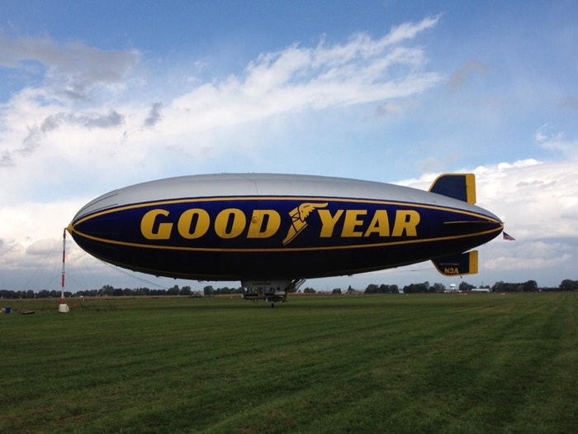
Northern Indiana - Elkhart Prairie

Slide 9
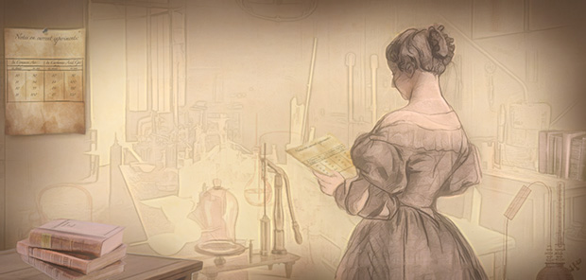
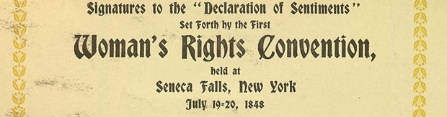

Eunice Foote
  Hidden figure in
  climate research
Born in Goshen!
July 17, 1819 - 200 years ago this summer!
Daughter of Isaac Newton, Jr., a farmer from Goshen,… Connecticut that is…
Signatory of the “Declaration of Sentiments

Slide 10
  "Circumstances affecting the heat of the Sun's rays" from the American Journal of Science (1857).
Her paper was read (1856) at the AAAS meeting by … Joseph Henry.
Experiment: thermometers in glass jars. The sun’s heating effect was:
  Greater with water vapor than dry air,
  Highest in a jar with CO2.
https://www.education.com/activity/article/Observe_Greenhouse_Effect/

Slide 11
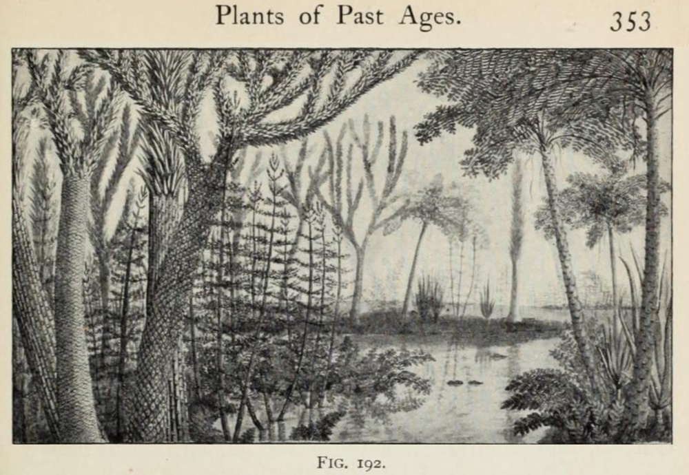
“An atmosphere of that gas [CO2] would give to our earth a high temperature; and if as some suppose, at one period of its history the air had mixed with it a larger proportion than at present, an increased temperature... must have necessarily resulted” (Foote, 1856).

Slide 12
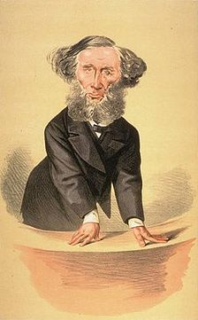
John Tyndall
By 1859 his laboratory work had identified two common atmospheric gases, carbon-dioxide and water (vapor) which trapped "heat rays", (infrared light)radiation.
He wondered if changes in Earth's atmosphere could play a role in such a massive change of Earth's climate as the Ice Age(s).

Slide 13
Greenhouse Gases
GHGs, for short, are gases which absorb infrared radiation (also called IR or heat radiation). They act like an "insulating blanket" on Earth, keeping energy trapped in Earth's atmosphere, that would otherwise escape to outer space.
The GHGs which have the most influence on Earth's temperature (and therefore climate) include: CO2, H2O, CH4, NOx, and refrigerants (CFCs)
Other gases which have no effect include Nitrogen, Oxygen, Argon, and Hydrogen.

Slide 14
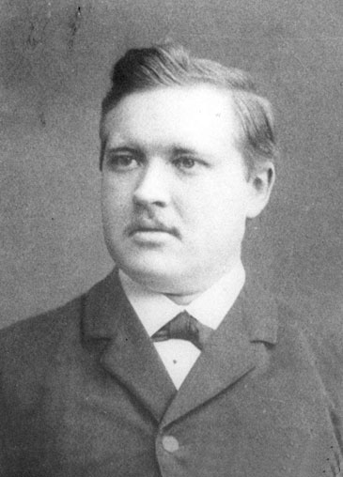
Svante Arrhenius
Swedish physicist / chemist,
Nobel prize, 1903, for his work on electrochemistry,
Also well known for his theory of acids and bases,
Hobby: trying to explain how ice ages came about.
He was the first to make a quantitative estimate of the change in Earth's temperature due to changes in CO2 levels:
Cutting the concentration in Earth's atmosphere in half would lower the average temperature in Northern Europe by about 4-5 C--a temperature drop compatible with the ice ages.

Slide 15
Arrhenius’ friend
He consulted a friend, Arvid Högbom, about the natural sources (and sinks) of CO2.
It occurred to Högbom to make a comparison of the amount of CO2 from factories and other human activities with geochemical (natural) sources,, and he found that they were about the same amount.
Arrhenius calculated the temperature change due to doubling the CO2 in the atmosphere, and estimated a temperature rise of 5-6 C
But he thought it would take many centuries for this to happen.

Slide 16
Charles Keeling
...Heard about Arrhenius' work, and wondered how levels had changed since then. He developed an instrument to measure carbon dioxide in Earths atmosphere as a graduate student. He used it in the mid-1950s and found:
Carbon-dioxide levels were above those measured in the 19th century--Pre-industrial levels are now thought to have been about 280 ppm.
There was a strong seasonal variation in these levels.
He finished his PhD, but thought it would be interesting to keep track of CO2 a little longer. But where to go for the best measurement??

Slide 17
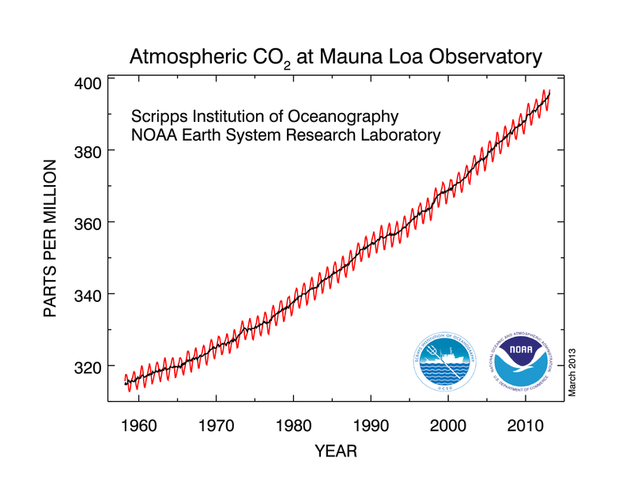
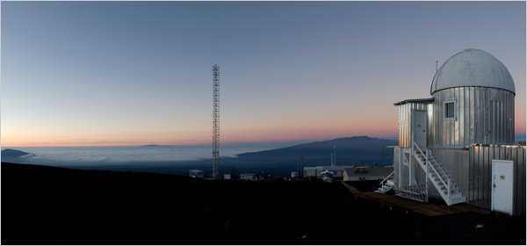
Mauna Loa observatory

Slide 18
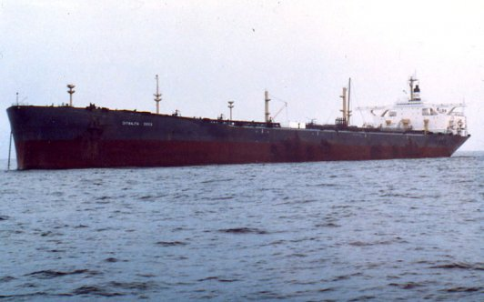
Confirmed by … Exxon
Exxon used its fleet of tankers to confirm the rise in the 70s.on 70s), and also concluded it was rising.

