Slide 1
The Music of Ice
By Ryan Snider
https://www.nytimes.com/2023/03/16/arts/music/melting-ice-music.html

Slide 2
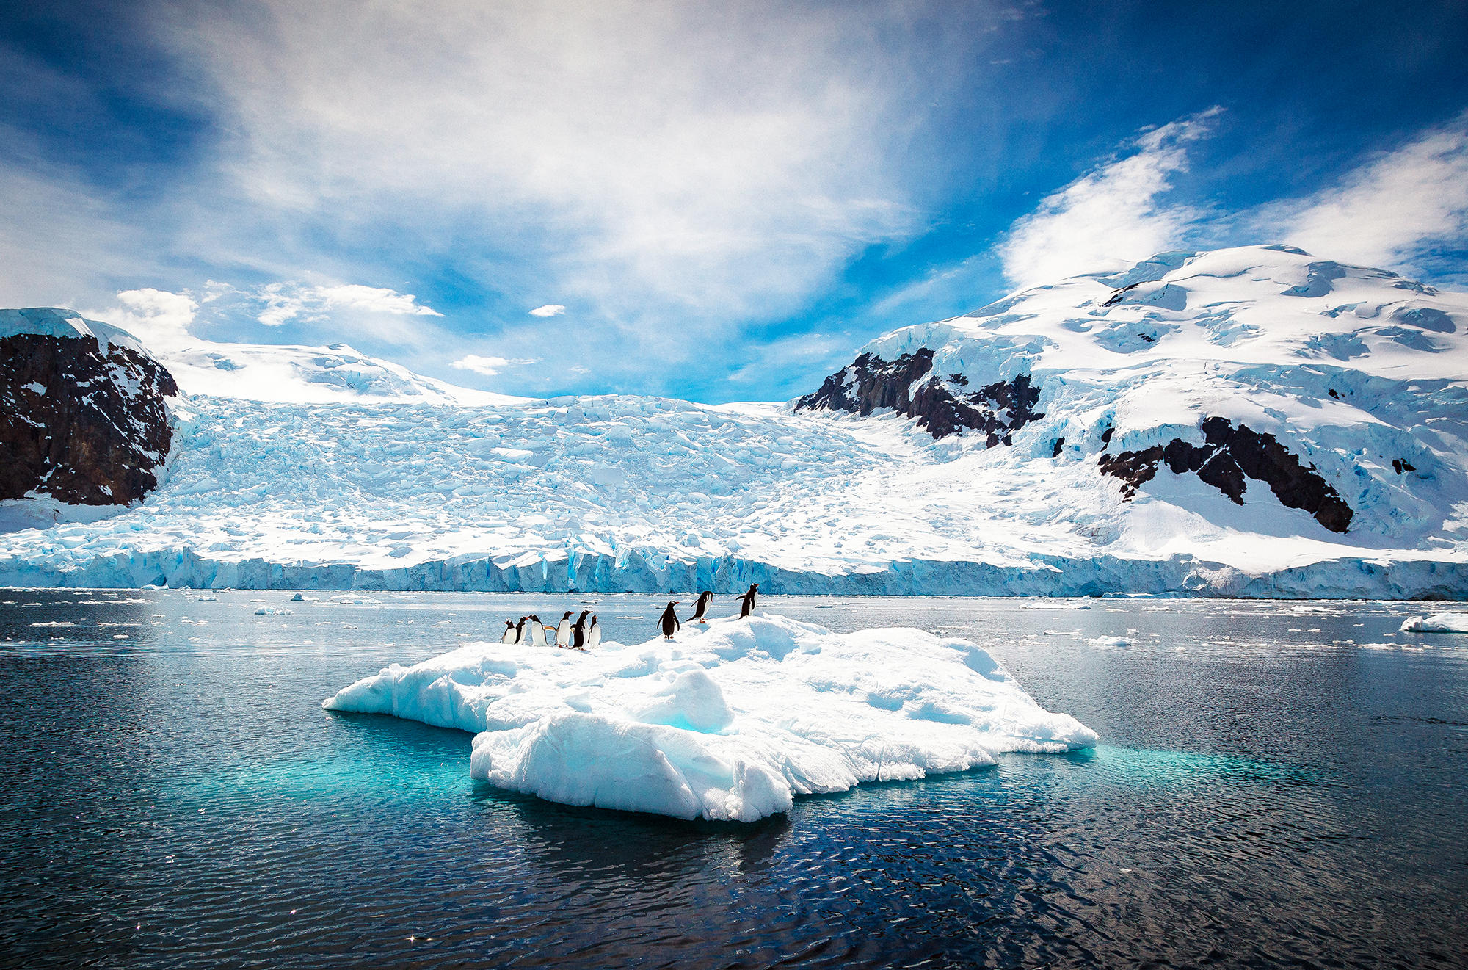
Burying Microphones in an Ice Cap?
Back in 2009, Martin Sharp (a glaciologist at the University of Alberta) had buried 7 microphones, GPS sensors, and seismic monitors to observe the rate the ice was melting on top of the ice cap. In an afterthought he put a handheld audio recording device up with the other gear

Slide 3
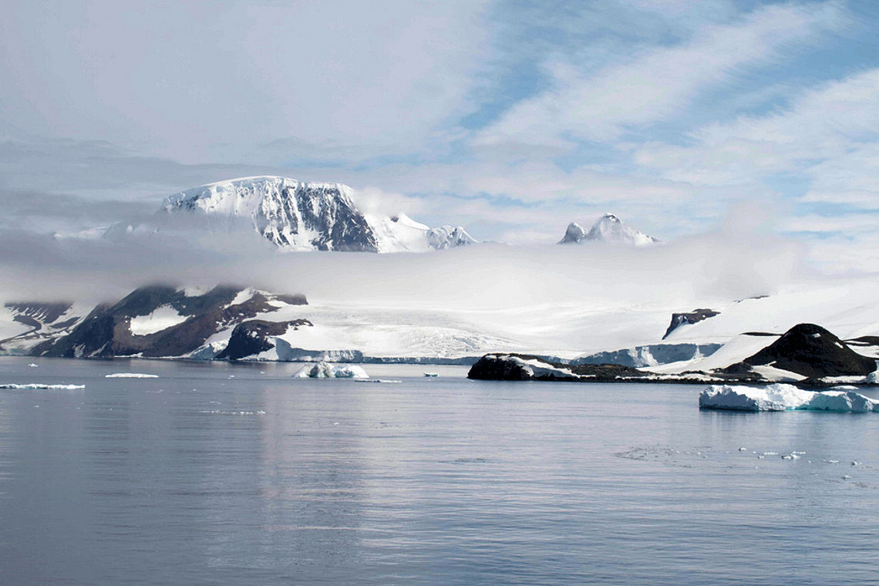
It sounded… Good?
To his surprise, the sound was fascinating. You could hear nearby animals, but also things from deep below. Deep ice was slowly thawing and a drone of water trickling ominously was heard. Tiny bubbles trapped between the ice exploded, creating popping sounds!

Slide 4
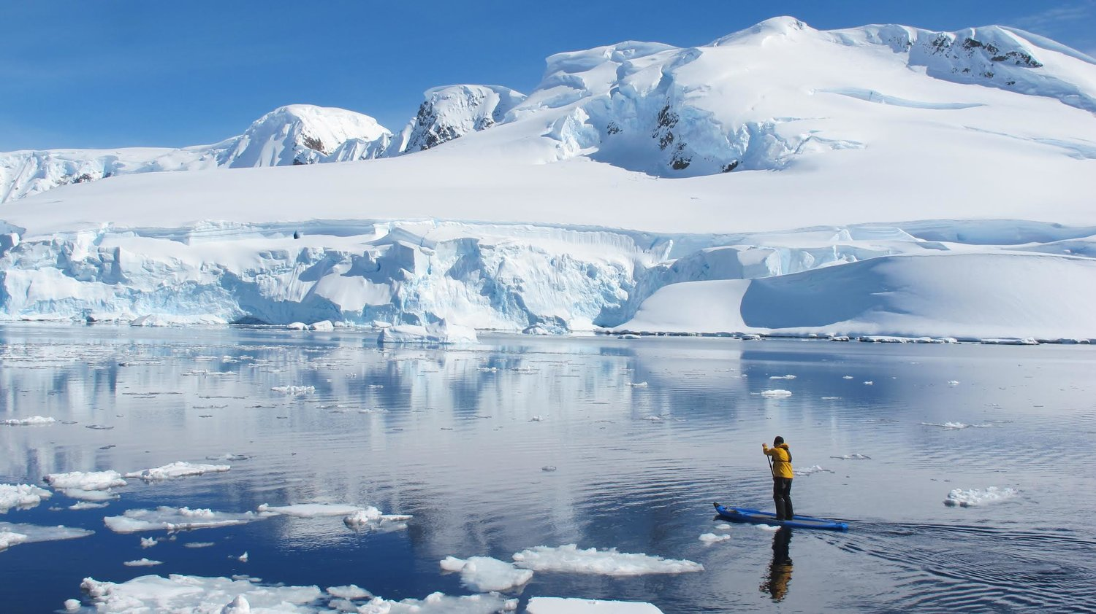
Others liked it too!
Martin began to play these audio recordings during his lectures, to make the slideshows less boring. And people loved it. The Intergovernmental Panel on Climate Change asked for a copy. The sound conveyed an atmosphere of what it was like to be there, with the glacier. Bringing a new way to experience the climate crisis.

Slide 5
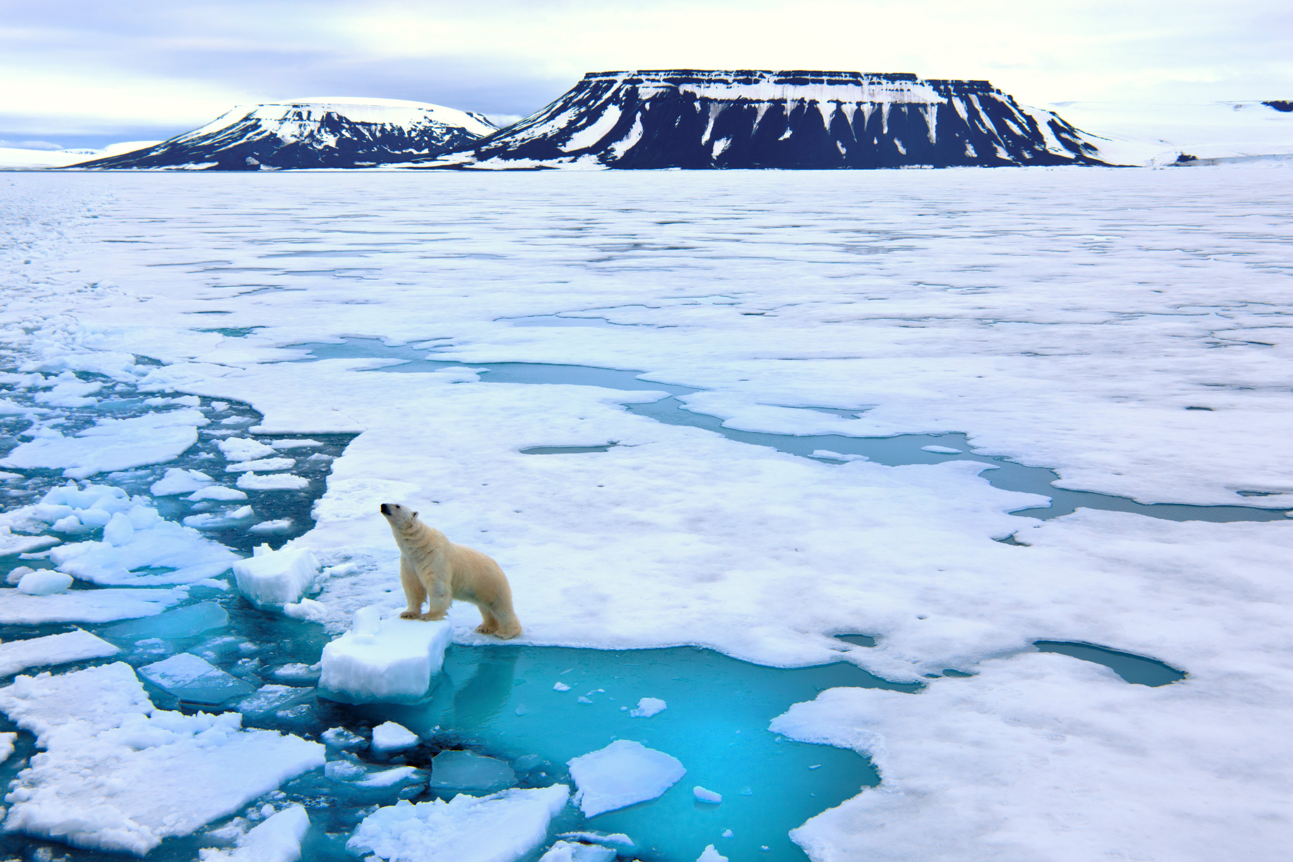
Ice Goes Viral!
More recently, these random ice sounds have gone viral. Artists like Mia Feuer, Jana Winderen, & Thomas Koner began to try at it again. Recording splintering glaciers or the slow grind of a glacier creeping along the earth on water sediments (Which apparently sounds like a tractor engine). All culminating in a haunting picture painted by sound.

Slide 6
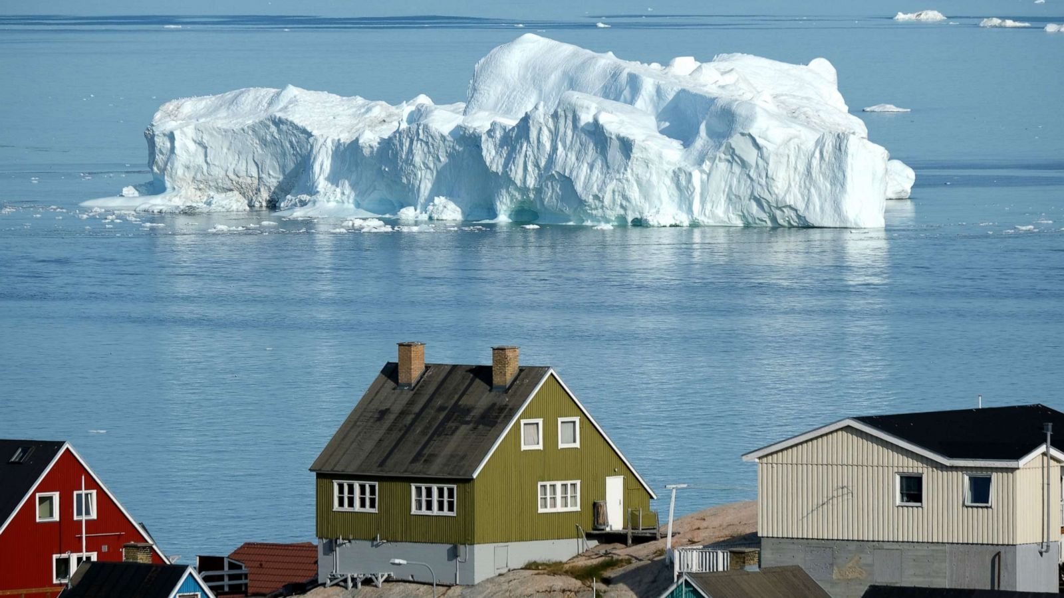
…So What?
This type of science data isn’t more accurate than the other technology we have to measure climate change. BUT it does provide a way to connect with the public. These fascinating slowly violent noises create a sense of empathy. Because with sound, we can better put ourselves into the reality that is climate change.

