Slide 1
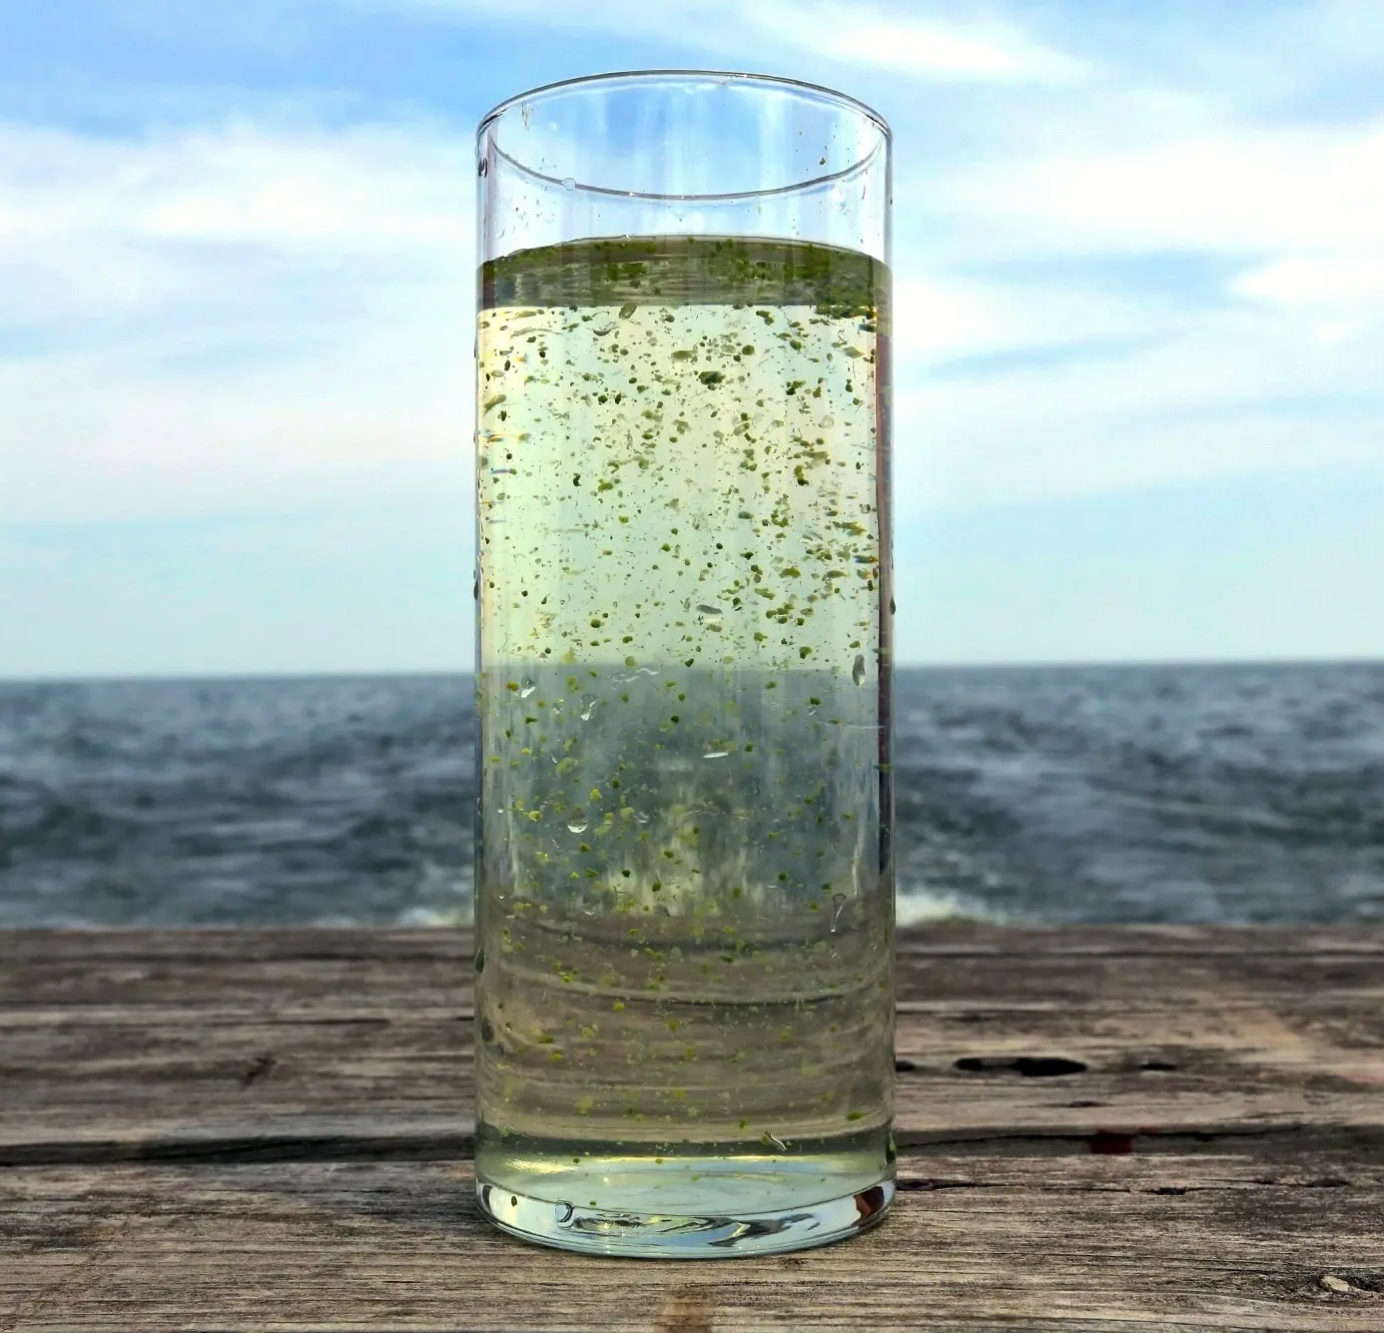
How Climate Change Puts the Safety of Drinking Water at Risk
Ariadna Otín O’callaghan

Slide 2
Contents
01
02
03
04
05
06
Introduction
Water systems and Climate Change
Real examples
Global Impacts
Solutions & Adaptations
Conclusion

Slide 3
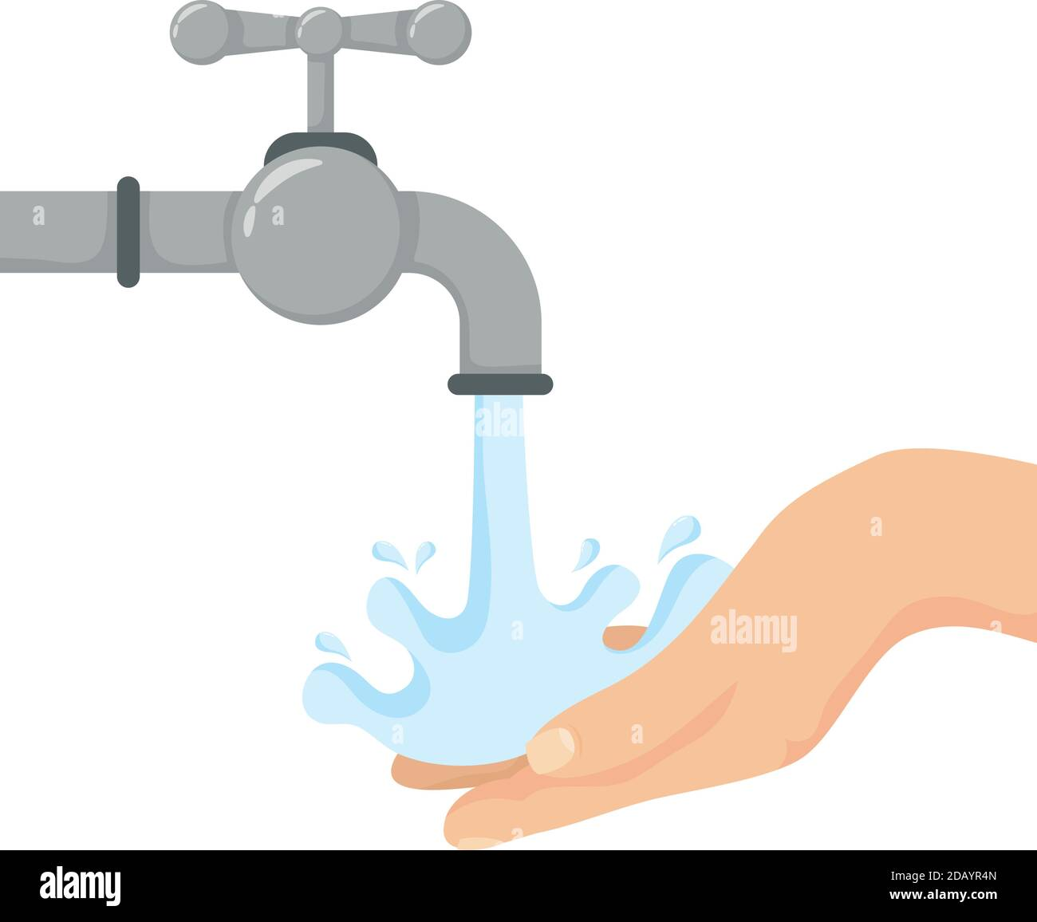
Introduction
CLIMATE CHANGE
Affecting environment → water systems!
Including: droughts, floods, water quality problems…
How climate change influences access to safe water?
Real examples (US + rest of world)

Slide 4
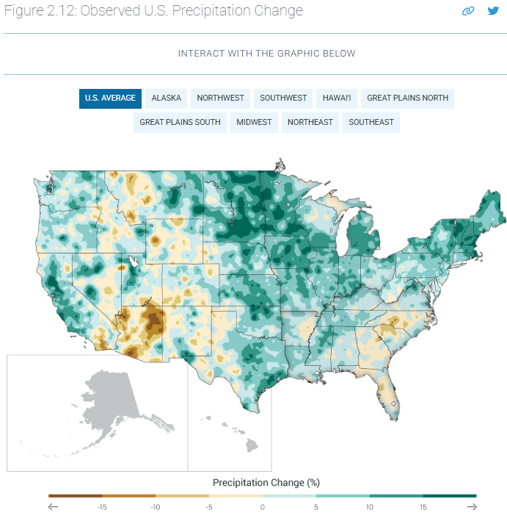
Water Systems and Climate Change
Include rivers, lakes, groundwater, how water is stored and delivered.
Changing rainfall patterns and increasing temperatures.
More droughts, stronger storms, changes in water quality…
Harder for communities to get clean water.

Slide 5
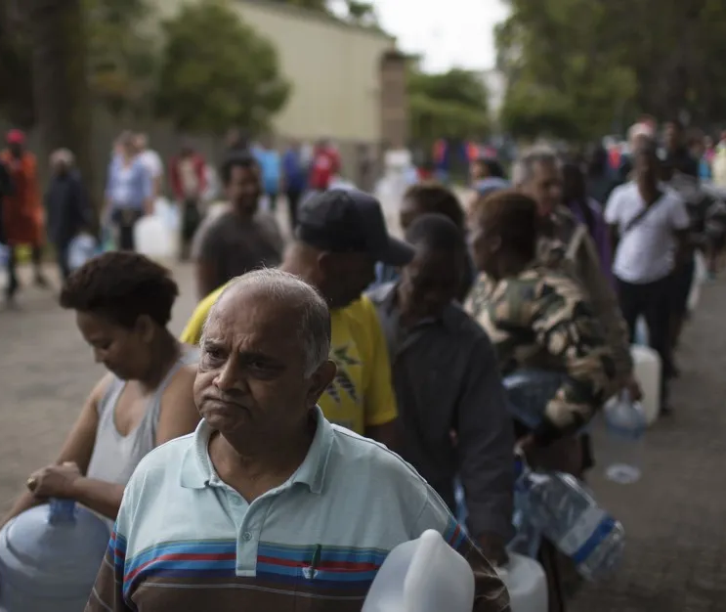
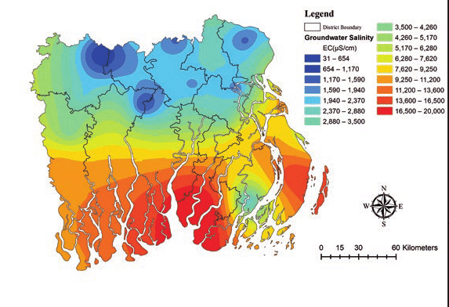
Real examples
CALIFORNIA, USA
CAPE TOWN, SOUTH AFRICA
Frequent and intense droughts → declines in water reservoirs. Affects urban areas and agriculture (almonds or grapes).
2018 → close to “Day Zero” (would run out of tap water). Strict water limits, line up for water at distribution points.
BANGLADESH
SPAIN
Sea level rise → saltwater mixes with freshwater sources (coastal areas) → damages rice fields and limits access to clean water for people.
Some areas (Andalusia) → less rain + hotter temperatures.
Water stress for farmers (olives and citrus fruits) and local communities.

Slide 6
Global Impacts
ECONOMIC CONSEQUENCES
Sectors like agriculture, tourism, and energy (especially hydroelectric power) are directly affected. This can slow down development and put pressure on already fragile economies.
FOOD INSECURITY
MIGRATION AND CONFLICT
HEALTH RISKS
When water becomes limited or unpredictable, farming becomes harder. This leads to lower crop yields and higher food prices.
In some places, people are forced to leave their homes due to drought or water pollution. Scarcity can also cause tension or even conflict between communities or countries sharing the same water sources.
Changes in water systems can increase the spread of diseases like cholera and malaria. In many areas, people also lose access to clean drinking water, which affects hygiene and public health.

Slide 7
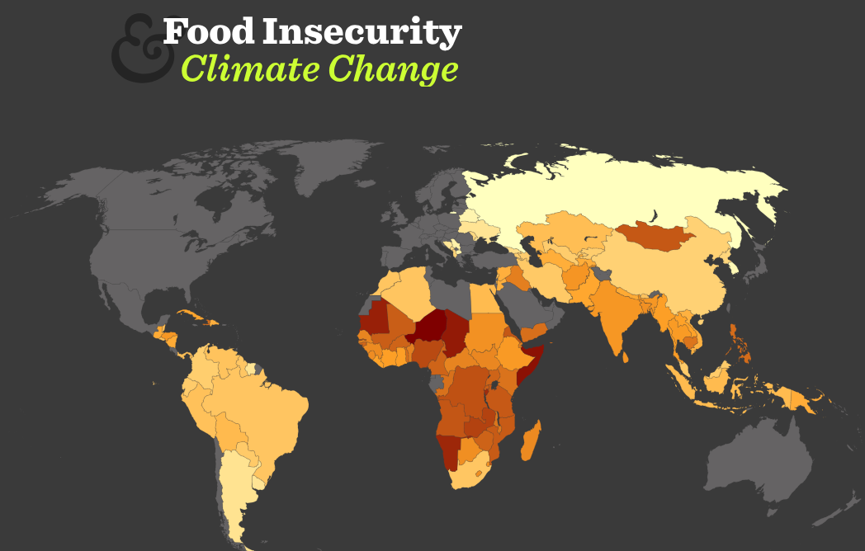
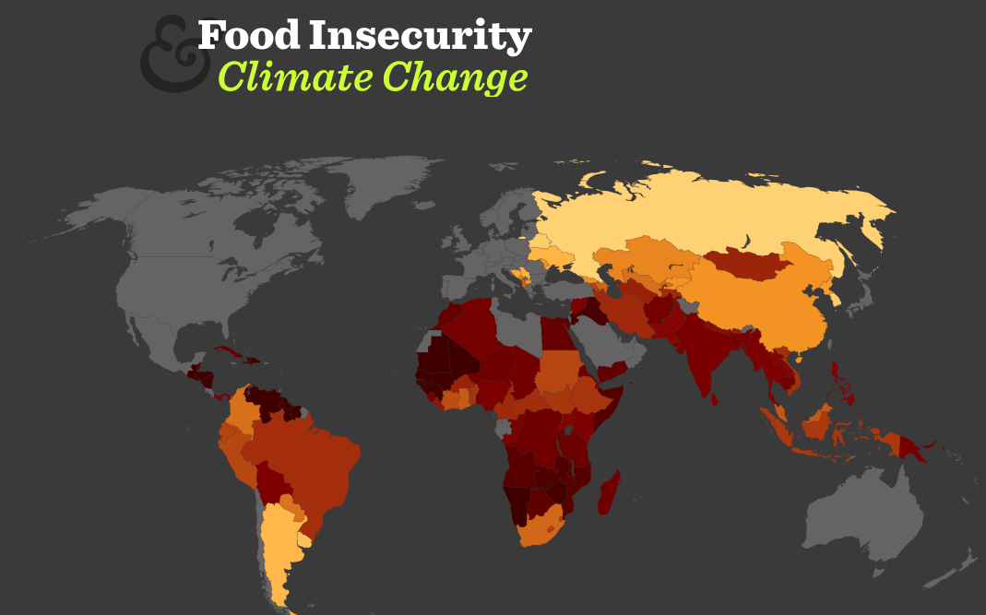
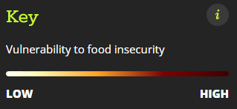
Climate change food insecurity map
2025
2080

Slide 8
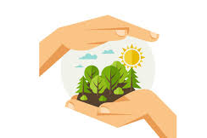
Solutions &
Adaptations
SUSTAINABLE WATER MANAGEMENT
Using water more efficiently in farming, homes, and industry.
PROTECTING NATURAL ECOSYSTEMS
Wetlands and forests help regulate water cycles. Protecting them can reduce flooding and improve water quality.
EDUCATION AND COOPERATION
Teaching people about water conservation and encouraging governments to work together.

Slide 9
Conclusion
01
02
03
Climate change has serious impact.
There’s solutions! (water management, protecting ecosystems, improving infrastructure…)
ACT NOW! Reduce risks, and let better future for next generations

Slide 10
Thank you for listening!

Slide 11
Sources
Article: https://e360.yale.edu/features/climate-change-drinking-water
Bangladesh foto: https://www.researchgate.net/figure/Shallow-groundwater-salinity-in-the-study-area-Based-on-data-from-the-Bangladesh-Water_fig3_325438078
Food insecurity map: https://www.metoffice.gov.uk/food-insecurity-index/
Precipitation change map: https://nca2014.globalchange.gov/report/our-changing-climate/precipitation-change
Sink foto: https://www.alamy.com/hands-human-washing-with-water-and-faucet-vector-illustration-design-image385385525.html

